Slide 1
Ground rules
Sustainable
Our PPTs default mode is dark. Energy saved in every slide. Navigate through the bright cover slides and use the Knowit-black-background for everything else.
Accessible
Our columns are narrow and line lengths short for an easy, and accessible read
Keep it simple
Highlight only what strengthens your story. Leave everything else behind. And make every illustration count ☺

Slide 2
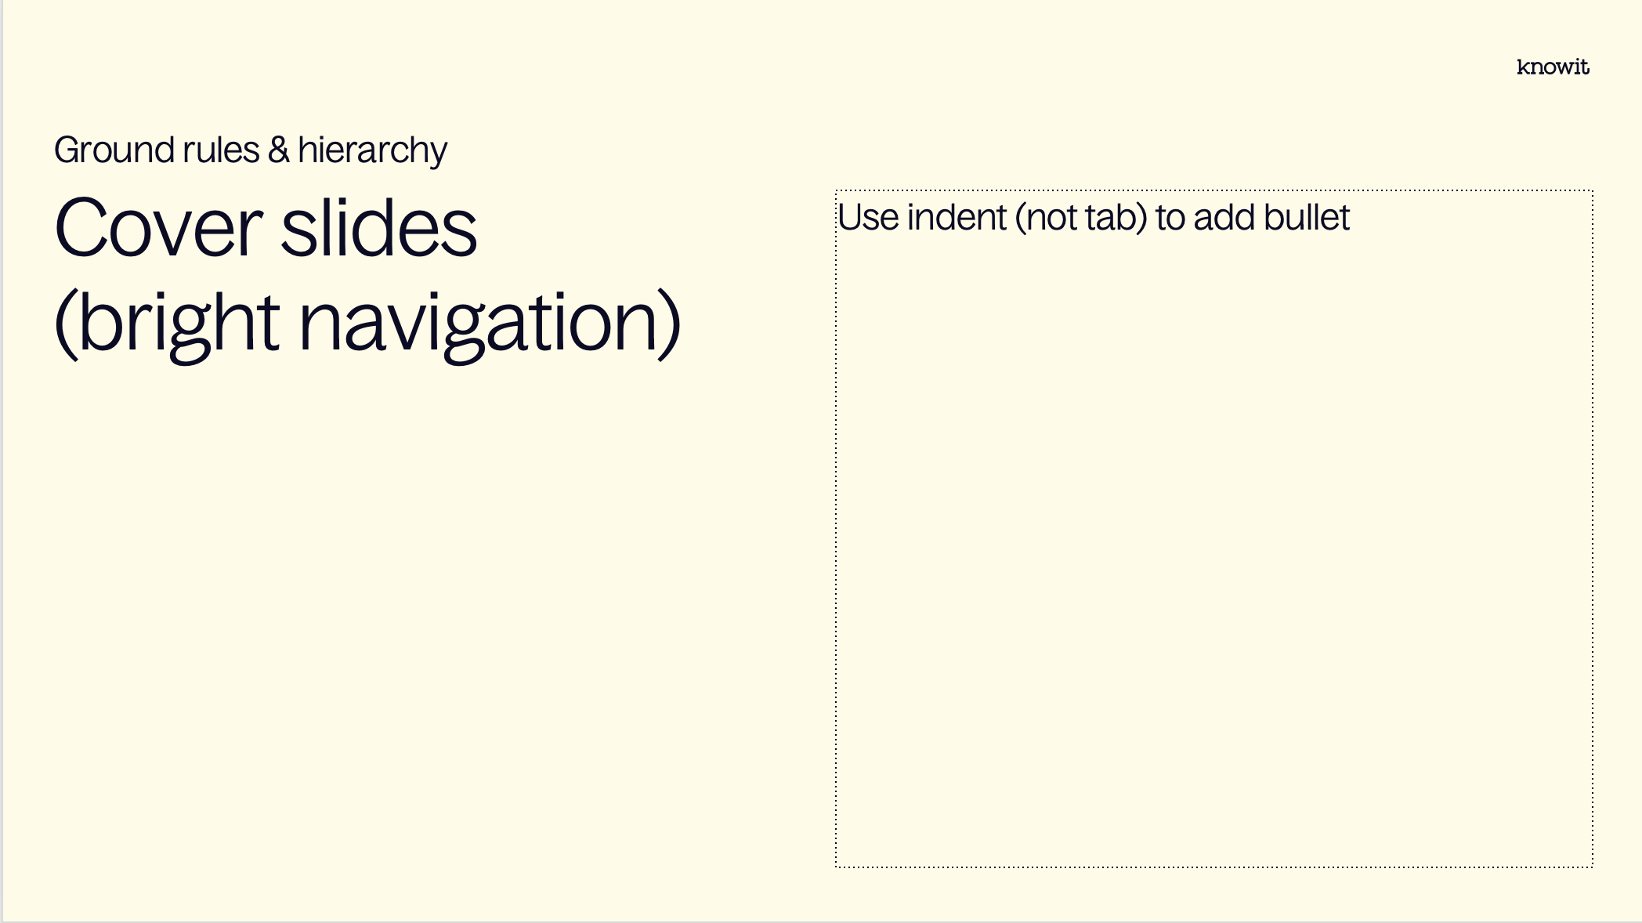
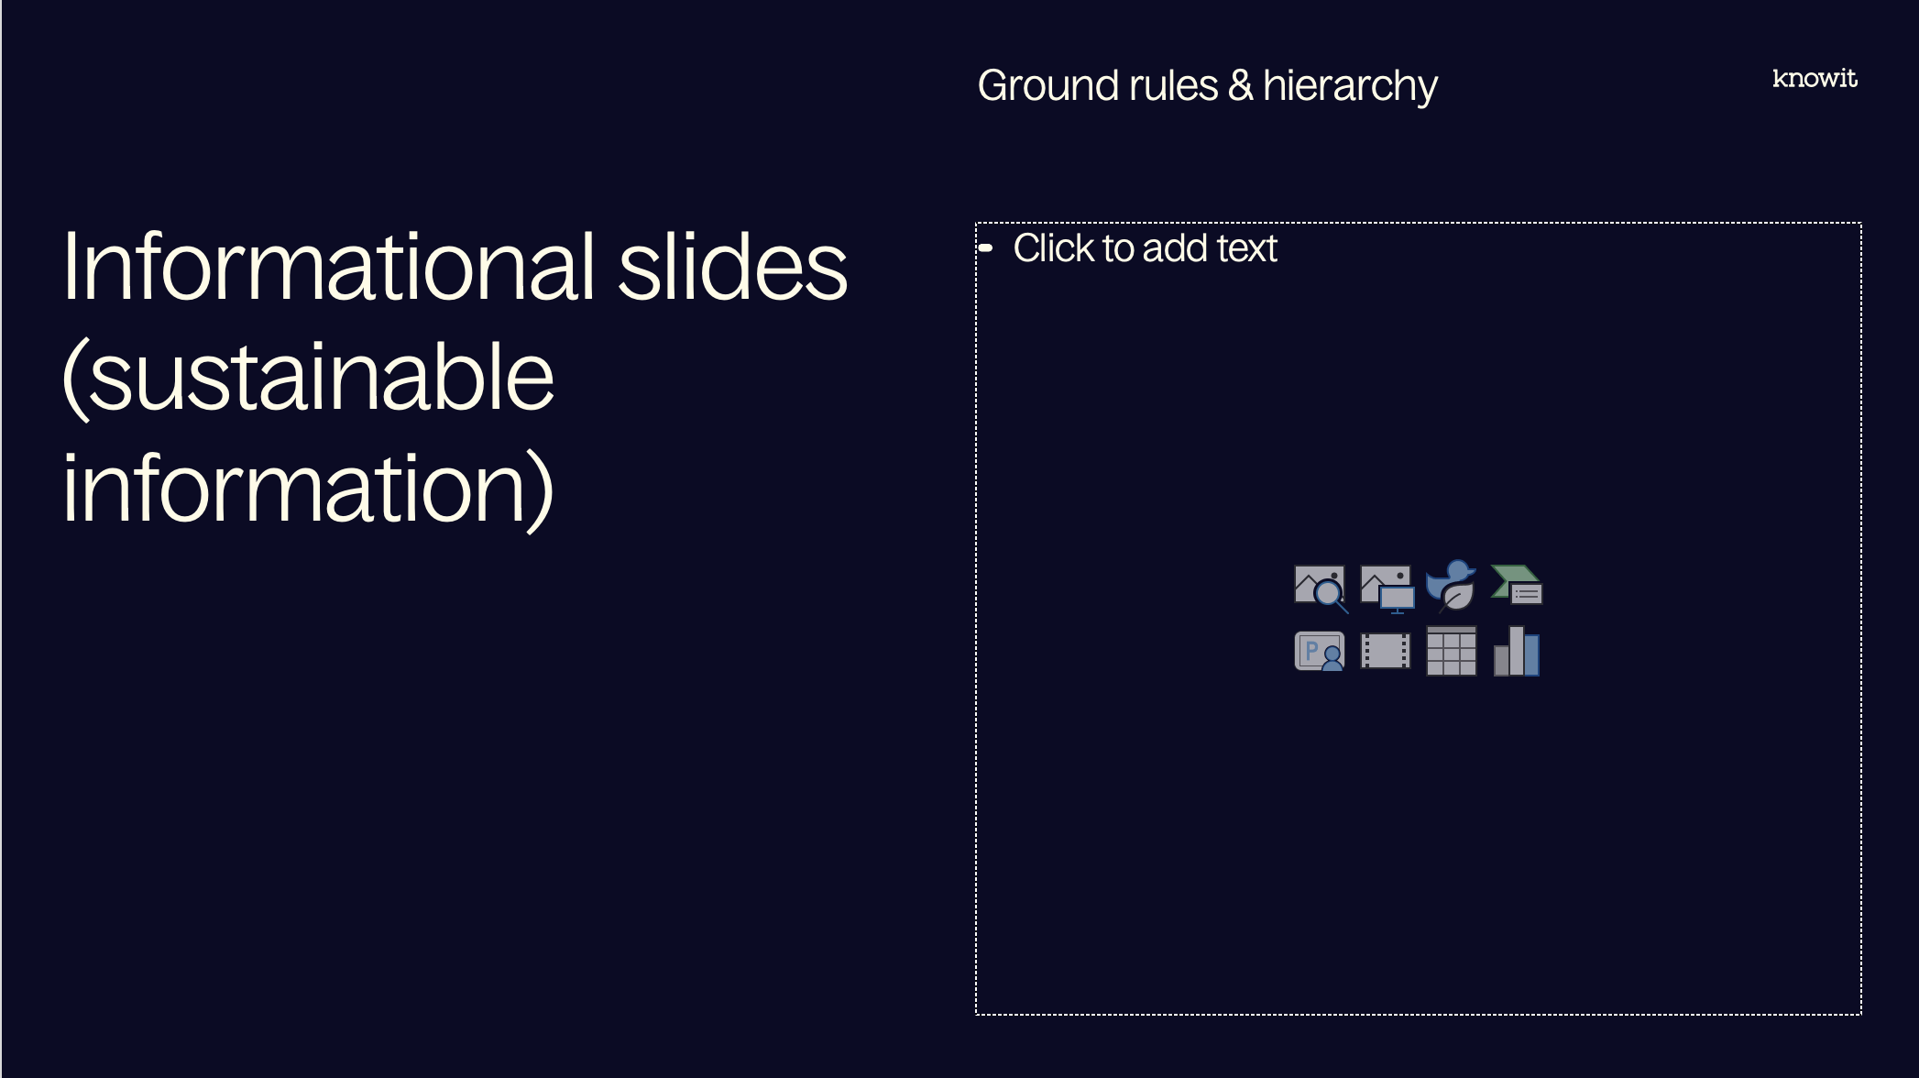
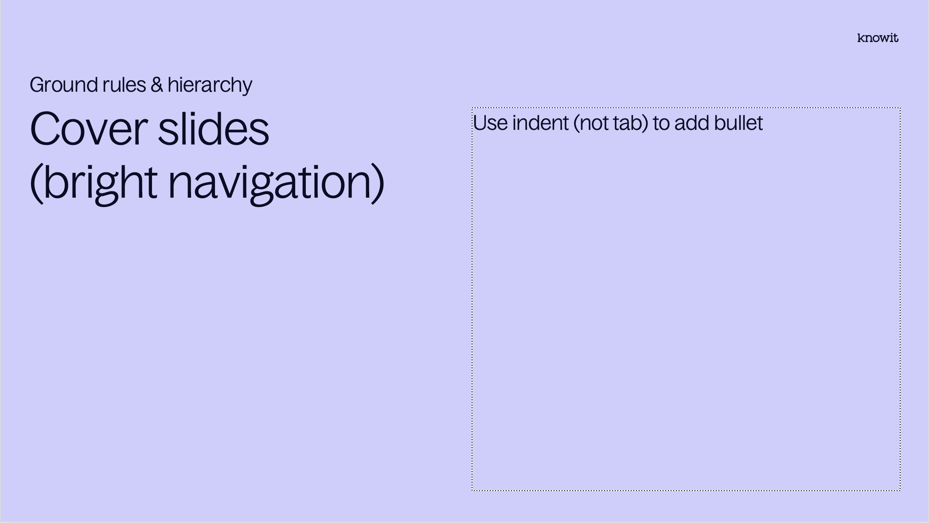
Visual prioritization

Slide 3
PowerPoint skills
Tips
Our template contains 38 different layouts, choose with care (and ask a colleague if you can’t find them)
The layout names might be helpful
Confused about colors or typographic rules? Check out the margins for some guidance
Have fun! (Break some rules if it helps you elevate your kick-ass-content☺)

Slide 5
Embedded academy

Slide 6

Who am I?
33 years old
Studied engineering physics at Chalmers
Started at Box of Energy, startup in Gothenburg
Previously four years at Aros electronics
Working at Knowit since May 2022 with engcon

Slide 7
Course overview
Course overview
Four Tuesdays 16.00-20.00
Tuesday 12th November: Introduction
Tuesday 19th November: Assembler and compilers
Tuesday 26th November: Electronics and HW interfaces
Tuesday 3rd December: Communication interfaces
Every session will be around 2 hours of lecture and 2 hours of lab, related to the content in the lecture
Resources available on Github, feel free to play around and test things on your own
Reach out if you have any questions or have hard time understanding some concepts
Disclaimer! Use this course as advisory information. Adapt what you learn to your context and look up details as needed.

Slide 8

Course content
Course overview
Tuesday 12th November: Introduction
Processor components
Processor manual
Hex and binary numbers
Memory types (flash, ram, stack, heap etc)
RTOS (semaphores, threading, FreeRTOS)
Tuesday 19th November: Assembler and compilers
Arm assembler
Compiler flags
Testing assembler code
Debugging
Map and list files
Tuesday 26th November: Electronics and HW interfaces
Processor manual, deep dive
DAC and ADCs
Timers and Interrupts
Voltage dividers
Level switches
Measurement
Tuesday 3rd December: Communication interfaces
SPI
UART
I2C
J-tag
Other topics

Slide 9
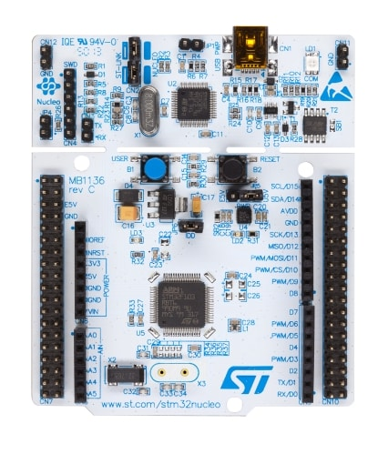
Lab
Course overview
Approximately two hours every session will be dedicated to a lab related to the lectures
Labs will be performed on a STM32 Nucleo-64 development board with peripherals
Dev boards are available on all sites with participants, please share them among each other
During the course we will implement drivers, write assembler code and play with peripherals
Requires STM32CubeIDE for easy target compilation and debugging
Collaboraion is encouraged, help eachother and discuss solutions with eachother

Slide 10
Embedded academy Introduction

Slide 11
Content
Introduction
What is embedded?
Processor components
Processor manual (first look)
Memory types
Real-Time Operating System (RTOS)
Hex and binary numbers

Slide 12
Lab
Introduction
This week the lab will let us get to know the IDE, some basic interfaces and show us how to debug on the board.
It will also involve getting to know a RTOS and using different threads.
The end goal is to blink a led on the board using FreeRTOS, both using a timer and pushing a button.

Slide 13
What is embedded?

Slide 14
Definition
What is embedded?
Not very well defined. Qt states the following which I felt summarize the general opinion quite well
An embedded programming language is a programming language that developers use in embedded systems. In general, the languages offer low-level access to the device hardware. Developers use several common programming languages for embedded systems.

Slide 15
Differences from other types of programming
What is embedded?
Specialized for certain hardware
Real time requirements
Limited resources
Demanding test and validation
Minimalistic user interface
Safety can have other aspects

Slide 16
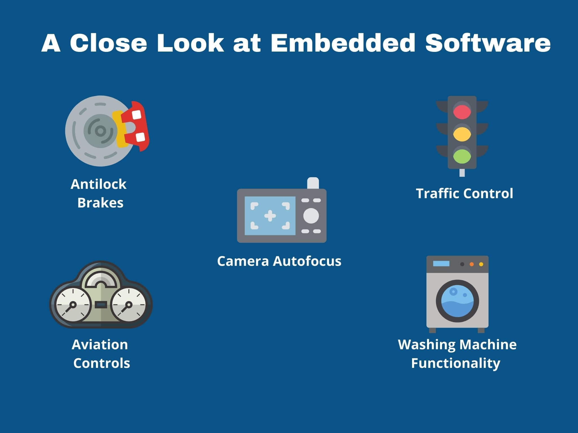
Examples
What is embedded?

Slide 17
Processor components

Slide 18
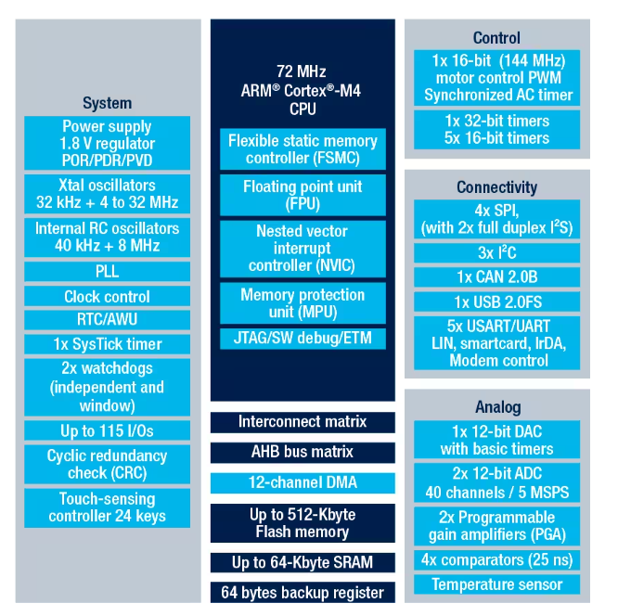
Overview
Processor components
STM32F302x6/8

Slide 19
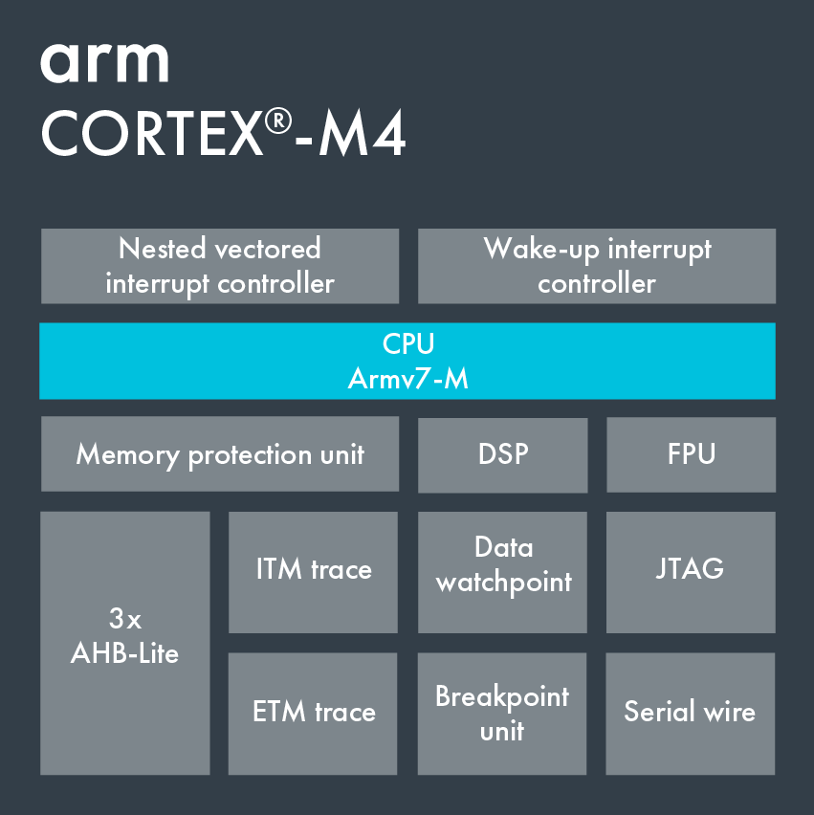
Common components - CPU
Processor components

Slide 20
Common components - Peripherals
Processor components
DAC
ADC
Timer
CCU
RTC
Watchdog
POSIF
PWM
Communication interfaces (SPI/I2C/UART/CAN)

Slide 21
Processor manual

Slide 22
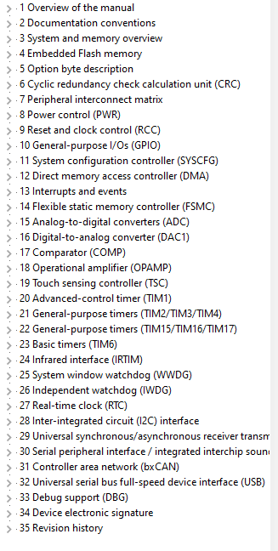
Overview
Processor manual

Slide 23
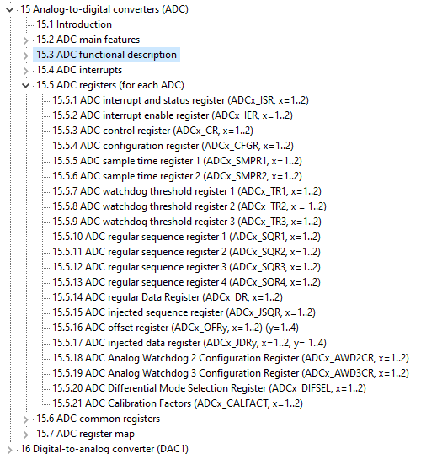
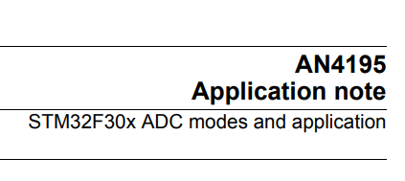
Overview
Processor manual
Lot of information in manual
Usually good help from Application Notes

Slide 24
Memory types

Slide 25
Memory types Overview
Memory types
Flash
RAM
EEPROM
Stack
Heap

Slide 26
Flash
Memory types
Non-volatile (stays the same after reboot)
Read only (with exceptions)
Contains op codes (basically your code)
Could also be external storage
Limited number of erases possible
Slow
Use const to force variables to be stored in flash

Slide 27
RAM
Memory types
Volatile (will be cleared on reset)
Fast
Read and write
Basically unlimited writes
This is where global variables are stored
Use static to place variables here

Slide 28
Eeprom
Memory types
Electrically Erasable Programmable Read Only Memory
Non-volatile memory
Handles more writes
Quite slow
Usually used for storing parameters which needs to be changed during runtime and stored between restarts
Could be replaced by FRAM for faster reads

Slide 29
Stack
Memory types
Software implementation
Stored in RAM
LIFO
If too small, an overflow could cause a lot of undefined and hard to debug errors
This is where function variables are stored

Slide 30
Heap
Memory types
Dynamically allocated memory.
Achieved with stdlib-function such as malloc() and free()
Usually avoided in embedded C, dynamic memory allocation is quite dangerous and need to be safe

Slide 31
Real-Time operating system

Slide 32
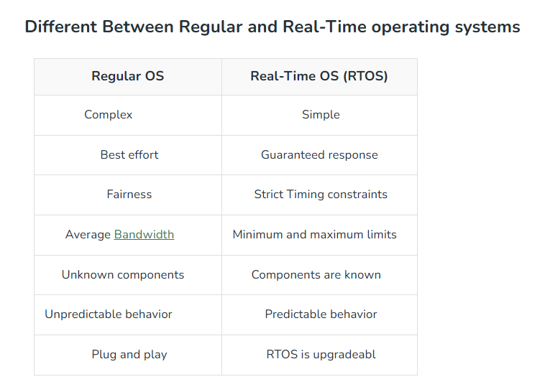
Purpose
Real-Time operating system
Focused on running short fast tasks and finish on time, usually within milliseconds
Ensures predictable and reliable behaviour
Can be event driven or time sharing
Can be hard or soft real time

Slide 33
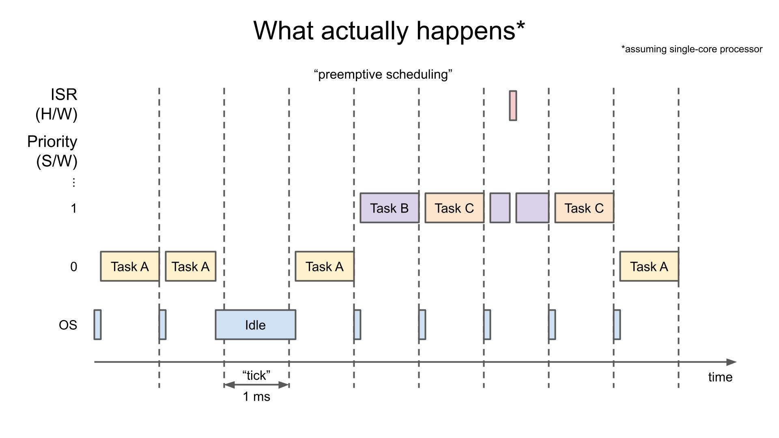
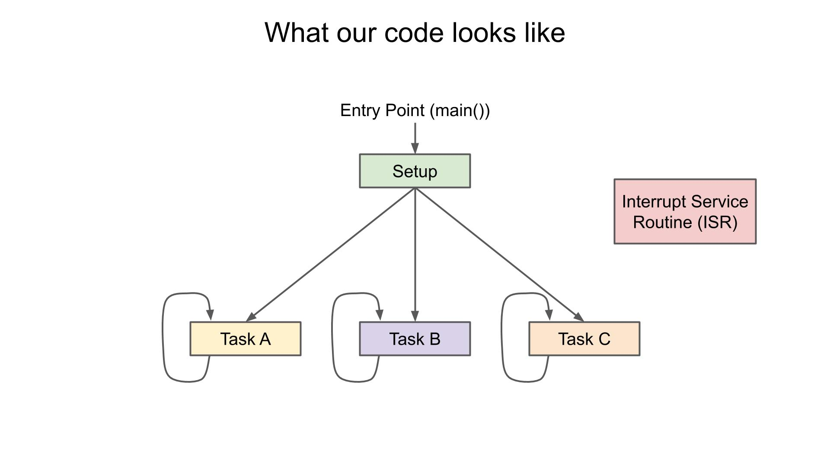
Scheduler and threading
Real-Time operating system
Priority based scheduler
Threading

Slide 34
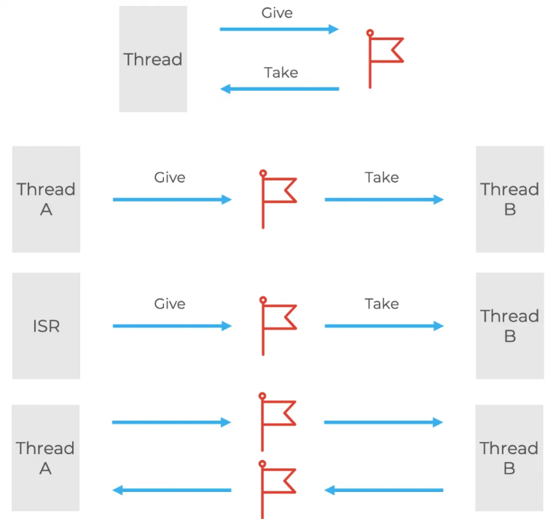
Semaphores and mutexes
Real-Time operating system
Prevents access to shared resources
Often described as a lock
Can end up in deadlocks
Semaphores can be counting semaphores
A binary semaphore and a mutex is very similar
A mutex has priority inheritance

Slide 35
Other components
Real-Time operating system
Memory management takes care of the stack
Symmetric multiprocessing, used with multiple cores
Function library, common function written in an efficient way
Clocks and timers
Different queues
Power management, especially for low power devices
Peripheral drivers, SPI, UART, etc.
Protocol stacks such as BLE or Wifi

Slide 36
Implementations
Real-Time operating system
FreeRTOS
SafeRTOS
Embedded Linux

Slide 37
Hex and binary numbers

Slide 38
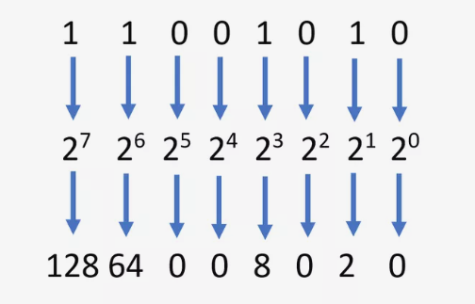

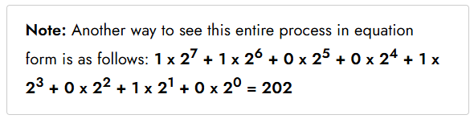
Binary numbers
Hex and binary numbers
Processor only uses 0 and 1, thus all numbers a stored in binary
Binary is simply base two, rather than base 10 as the decimal system
Indicated with 0b when coding
128 + 64 + 0 + 0 + 8 + 0 + 2 + 0 = 202

Slide 39
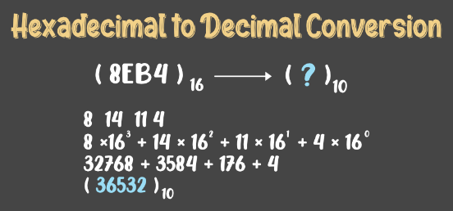

Hex numbers
Hex and binary numbers
Hexadecimal numbers are commonly used in embedded programming
Uses base 16 and lets A = 10, B = 11, C = 12, D = 13, E = 14 and F = 15
Indicated with 0x when coding
Two hex numbers corresponds to one byte or eight bits

Slide 40
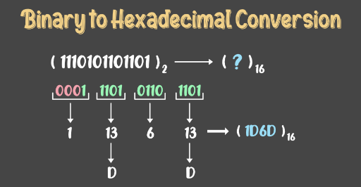

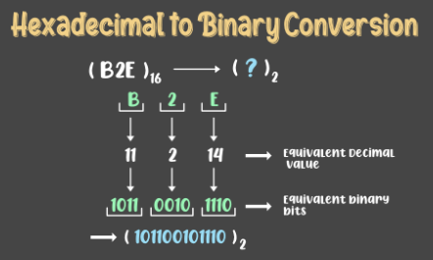
Correlation between hex and binary numbers
Hex and binary numbers
One hex digit matches four binary digits
Easy to convert between hex and binary
More dense with hex format
Useful for bitmasks for example
Commonly used when interacting with processor registers

Slide 41
Questions?

Slide 42
Lab part

Slide 43
Lab
Introduction
This week the lab will let us get to know the IDE, some basic interfaces and show us how to debug on the board.
It will also involve getting to know a RTOS and using different threads.
The end goal is to blink a led on the board using FreeRTOS, both using a timer and pushing a button.

Slide 44












































































Our icons

Slide 45

















UN SDG (PNG)

Slide 46

















UN SDG (SVG)

